Slide 1
Uncontrolled copy not subject to amendment
Airframes
Revision 1.00

Slide 2
Chapter 2:
Materials

Slide 3
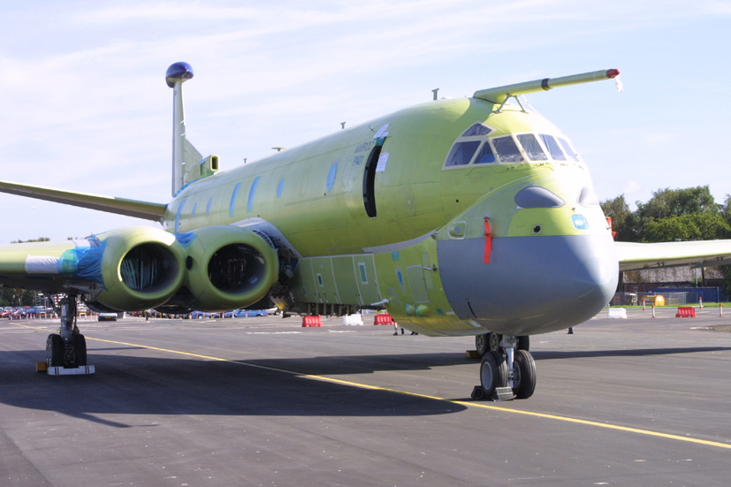

Slide 4
Learning Objectives
The purpose of this chapter is to make you aware of the many different materials employed in an aircraft’s structure, it’s properties and application.
So, by the end of this presentation you will be able to identify the main materials used in aircraft construction, where they are used and what properties are beneficial in supporting the design.
But first a recap of Chapter 1 with some questions.

Slide 5
Chapter 1 Revision
A few questions about the previous chapter.
How many major components make up an airframe?
Name the 5 types of forces (or loads) that would be present in components of an aircraft wing?
What structural element is used to counter a tensile force (or load)?
What is a ‘Cantilever’ and can you name any examples?

Slide 6
Materials
In the early days of aviation, airframes were built from wood, canvas and steel wire.
However, modern airframe designs use a variety of different materials in their construction and it now common to find the following materials within the main structure.
Carbon Fibre Reinforced Plastic (CFRP)
Aluminium and Magnesium Alloys
Plastics
Titanium and Titanium Alloys
Glass re-infored aluminium laminate (Glare)
Composites
Steel and Steel Alloys

Slide 7
Material Design Factors
Due to the many different factors to consider, it is difficult to say how different materials can be compared.
  Some will be better at resisting tension (stretching) better than others
  Some will be better at resisting compression (squashing)
  Other materials will be better at coping with extremes of temperature
  And so on……..
Even different types of aluminium alloys are preferred for different types of loads.

Slide 8
Material Properties
It is important that the materials used in Airframes be consistent and predictable in their properties – so we know what behaviour to expect from them!
The material to be used should be homogeneous (i.e It has the same properties throughout).
  However, the way in which a particular material is processed may upset this
  If it does, it must do so in a predictable way and leave the material in a useful state
The material should be readily available and at reasonable cost with the ability to be worked using current processes.

Slide 9
Material Properties
They should be able to withstand corrosion or other deterioration due to environmental effects
  Weather, sea water or man made chemicals that it may come in contact with
  Subjecting some materials to high loads and corrosive fluids can lead to Stress Corrosion Cracking
The material should be incapable of supporting a fire
  Magnesium alloys can burn fiercely when exposed to high temperatures
However, they should NOT suffer badly from fatigue (damage caused by stress).
  Or if to be used, can only be used in parts that are not subject to fatigue conditions

Slide 10
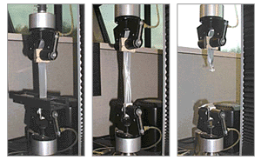
Strength to Weight Ratio
The best way to compare different materials is by considering their Strength to Weight Ratio.
  i.e. How much weight can be hung from a sample of the material before it fails under the excessive loading.
However, there are other things that can be considered as well as the Strength to Weight Ratio.

Slide 11
Aluminium and Magnesium Alloys
Pure aluminium and magnesium are completely unsuitable as airframe structural materials.
To be able to use them, they need to be alloyed (chemically mixed) with each other or with other metals, such as;
Once alloyed, they form the most common used of all airframe materials. Alloying allows for variations in properties, so that they can be tailored to different uses.
Zinc
Copper
Lithium
Manganese
Silicon

Slide 12
Aluminium and Magnesium Alloys
Aluminium Lithium alloys are superior to Al-Zinc and Al-Copper alloys in many respects.
  But they cost around three times as much, so their use is limited.
An interesting property of Aluminium is that, like Titanium, they can be Super-plastically Formed (SPF).
When the material is heated to a certain temperature just below it’s melting point, it becomes extremely pliable – much like thermoplastics.
It can then be inflated to fill a mould and take the shape exactly.

Slide 13
Al & Mg Alloy Advantages
The advantages of using Aluminium and Magnesium Alloys are:
  They have a high Strength to Weight Ratio and Can be alloyed with a wide range of other materials to suit a number of applications.
  They are generally lightweight, so can be used in greater thickness than heavier materials and are therefore less prone to local buckling.
  The material is available in many standard forms – sheet, plate, tube, bar, extrusions and is easy to work after simple heat treatment
  They have reasonable electrical and magnetic screening properties

Slide 14
Al & Mg Alloy Disadvantages
But, Aluminium and Magnesium alloys do have some disadvantages, specifically;
  Both Aluminium and Magnesium Alloys are subject to corrosion and need to have protective finishes applied.
  Both Aluminium and Magnesium Alloys are subject to fatigue and therefore it’s use in highly loaded components must be carefully restricted.

Slide 15
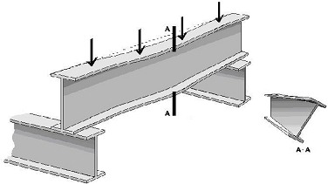
Steel and Steel Alloys
Steel is itself an alloy of pure iron and is therefore a Ferrous material
Steels will always contain carbon and may contain one or more of the following materials;
Steels can be produced with a wide range of properties ranging from extremely hard to very ductile (able to be bent and stretched).
However, they are all HEAVY,
so prone to local buckling
Nickel
Chromium
Titanium

Slide 16
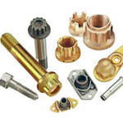
Steel and Steel Alloys
Steel finds most usage where it’s strength can be used to best advantage
  i.e. Where space is limited or where it’s hardness and durability are needed. Therefore, it is most commonly used in bolts and other fasteners.
It also performs better at higher temperatures than most other materials
  With the exception of Titanium!

Slide 17
Steel and It’s Alloys - Advantages
The advantages of using Steel and Steel Alloys are:
  The material is cheap and readily available
  Consistent strength – useful where space is limited. High tensile steels have a High Strength to Weight Ratio
  They have a wide range of properties available by suitable choice of alloy and heat treatment. Some Stainless Steels are highly resistant to corrosion
  Hard surface that is resistant to wear
  More suitable for use at higher temperatures than light alloys, but not as good as Titanium Alloys
  Easily joined and have very good electrical and magnetic screening

Slide 18
Steel and It’s Alloys - Disadvantages
Even with all those advantages, they do have some disadvantages;
  With the exception of High Tensile Alloys, the vast majority have a poor Strength to Weight Ratio.
  The material is heavy, so care must be taken no to use very thin sections, or buckling will result.

Slide 19
Titanium and It’s Alloys
Titanium and it’s alloys are expensive, but they have a high Strength to Weight Ratio
Titanium has properties close to steel, but are much lighter
  Can also maintain strength at high temperatures
  Hence the material is used extensively within Gas Turbines for components such as;
Jet Pipes
Casings
Ducts
Compressor Blades

Slide 20
Titanium and It’s Alloys
Titanium can be Super-plastically Formed, which allows very strong and light items to be manufactured, such as pressure vessels
Titanium can also be Diffussion Bonded, where two pieces of titanium are pressed together (at a precise temperature) and will fuse to become a single piece
  This allows for greater flexibility of design when combined with Super-plastic Formation

Slide 21
Titanium and It’s Alloys
With the increase in the use of Carbon Fibre Re-inforced Plastic (CFRP), Titanium components have become more attractive to designers
  The Co-efficient of Thermal Expansion of Titanium is very low – similar to that of CFRP, so that the two materials can be bolted together
  This minimises thermal strain experienced when the airframe temperature changes
  Potential difference between the two materials is also very low, which minimises Galvanic Corrosion.
  Therefore it is safe to have these two materials together as the risk of causing one to preferentially corrode is small

Slide 22
Titanium and It’s Alloys Advantages
The advantages of utilising Titanium and Titanium Alloys within airframes are;
  They have a much higher Strength to Weight Ratio than Steel
  Titanium and Titanium alloys maintain their strength at high temperatures
  They have a higher melting point and lower thermal expansion than other materials
  The material can be Super-plastically Formed and Diffusion Bonded
  Titanium is resistant to Fire, therefore it’s use is more prevalent in high temperature areas.

Slide 23
Titanium and It’s Alloys Disadvantages
Like all materials, there are disadvantages in using Titanium, specifically;
  Titanium is an expensive material
  It can be difficult to work – especially to machine
  It has poor electrical and magnetic screening
  A very hard scale can form on the surface of Titanium at high temperatures

Slide 24
Plastics & Composites
A Composite is simply two or more different materials combined to provide a material with enhanced physical properties.
  Usually a combination of fibres such as glass, carbon, boron or Kevlar with a Thermosetting resin such as epoxy
  The most commonly used composite within airframes is Carbon Fibre Re-inforced Plastic (CFRP)
Until recent times, composite materials have been limited to the construction of components within the interior of the fuselage and secondary structures
  Areas such as panels on wings, tail and engine nacelles

Slide 25
Plastics & Composites
Composite materials are now relatively common-place in airframe structures.
  Weight saved in the construction can be used to increase the aircraft’s performance
  For fighter aircraft, this could be a greater rate of acceleration and stores carrying capability
  For commercial aircraft, this could be a reduction in relative fuel burn per nautical mile

Slide 26
Composite Construction
The material properties of a finished composite component are not always in the same in every direction.
  The component is said to be anisotropic (i.e. Strength is dictated by direction). Therefore, the design of the component will dictate it’s properties in a given direction.
Not all composites are CFRP, sandwich panels may be constructed from CFRP with a paper of aluminium honeycomb core

Slide 27
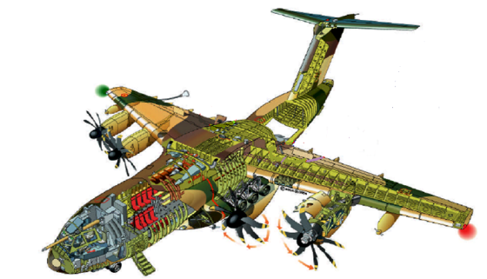
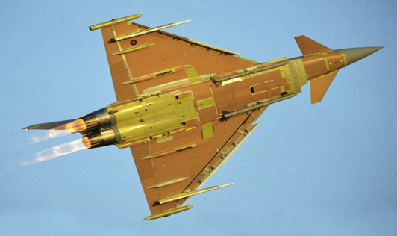
Examples of Composite Applications
The Typhoon, A400M and A350 airliner introduce more use of composite in the primary structure
  Both A400M and A350 use composites for the front and rear wings spars and for the wing skins
  A400M is approximately 48% by weight made of Composite materials, whilst the Typhoon is 50% by weight
  The use of Composite materials allows enormous weight savings. The empty weight of a Typhoon is only 70% of that of the similar sized Tornado

Slide 28
Design Considerations
There are two major design considerations when using Composite materials
  Lightning Strike Protection: Carbon composite is a poor electrical conductor, so a bronze or copper mesh is added during manufacture
    The addition of the mesh allows the electrical current from a lightning strike to be safely carried away and dissipated through the rest of the airframe
  Electromagnetic Shielding: Carbon composite is very poor at providing an electrical and magnetic shield for an airframe’s electrical and electronic systems (Avionics)
    EMC protection is required to ensure that these systems do not fail due to induced currents/signals from strong magnetic fields
    Therefore, additional shielding needs to be added which adds to the weight, cost and complexity of the design

Slide 29
Composite Damage
Composites are much more tolerant to fatigue than metallic structures, but are not damage tolerant
  Therefore, it is important to be aware of damage that can be caused by knocks, collision damage and abuse
Initially, impact damage will cause what appears to be a small dent in the surface, but the damage may be more extensive below the surface with matrix cracking, fibre crushing and delamination over a wider area

Slide 30
Composite Repair
The repair method selected depends largely on the type of structure and damage, but basically there are 3 types;
  Bolted Repair: involves machining off the damaged material and bolting a replacement plate (often metallic) in place.
  Cold Bonded Repair: involves repairing the damaged area with a matt of composite fibres, saturated in a cold-curing adhesive resin - Usually used in areas that have low strength.
  Hot Bonded Repair: involves using a fibre matt pre-impregnated with resin and the repair is cured by applying a controlled heat blanket.

Slide 31
Glass Reinforced Aluminium Laminate
Glass Reinforced Aluminium Laminate (GLARE) is used for the construction of panels
  Constructed from alternate layers of Aluminium sheets and Unidirectional glass fibre reinforcing sheets
  GLARE has a low susceptibility to corrosion as the glass layers act to retard moisture and also improve resistance to fire
  GLARE also has a better impact resistance that CFRP and is less susceptible to cracking than aluminium alloy
  Weight of GLARE is 10 – 30% lighter than aluminium, but is more expensive

Slide 32
Composite Advantages
The advantages of using Composites in airframe design are;
  They have a very high Strength to Weight Ratio
  They are good in Fatigue
  Composites are available in a wide range of forms
  They have a low resistance to RADAR and Radio Signals and are therefore ideal for radomes and antenna

Slide 33
Composite Disadvantages
However, there are some disadvantages to employing Composite materials:
  Composites are a highly specialist material and need special manufacturing and repair methods
  Their strength and stiffness is not the same in all directions and depends on method of manufacture
  They have poor electrical screening
  Damage is not immediately obvious and they require specialist Non-Destructive Testing (NDT) techniques to find damaged sections
  They can absorb water (especially honeycomb panels)

Slide 34
Conclusions
Modern airframes employ a variety of different materials in their design and the designer must choose the material with the correct properties.
Therefore thorough under-standing of material properties is needed to ensure that the designed components are safe and reliable.
You should now have an understanding of the ‘materials’ that make up an airframe, as well as how material properties influence the design.
Any Questions?

Slide 35
Questions
Here are some questions for you;
1. What does the term CFRP stand for?
2. What is Fatigue?
3. What are the two major design considerations involved in the use of Composite materials?

